Slide 1

Predicting Business Establishment Survival Across the U.S. Economy Using Business Dynamics Data
By Peter Myers
Spring 2025 Data 602 Final Project
Professor Ergun Kacar

Slide 2
Risky Business
According to Bureau of Labor Statistics, 48% of businesses close within their first 5 years.¹
Can we minimize the risk using machine learning and data?
Our Goal : Build a model that can help us know if we’re making a good decision when opening our business establishment in the United States.
More Specifically: Build a model that can classify our business establishment as ‘Likely to Survive after 6 years’ or ‘Not likely to survive after 6 years’

Slide 3
Data Set : Business Dynamics Statistics (U.S. Census Bureau)
“Business Dynamics Statistics (BDS) provides annual measures of business dynamics (such as job creation and destruction, establishment births and deaths, and firm startups and shutdowns) for the economy overall and aggregated by establishment and firm characteristics.”
“State by Metro/Non-Metro by Sector by Establishment Age Coarse [83MB]”
Last major release was 2022
Contains BDS surveys of US Economy for years 1978-2022

Slide 4
Data Set : Business Dynamics Statistics (U.S. Census Bureau)
How is it aggregated?
By State
By Metropolitan/Non-metropolitan areas within the state
By Business Sector (ex. Real Estate, Retail, Hospitality, etc)
By Establishment age (0 years, 1-5 years, 6-10 years, 11+ years)
By Year
What is it measuring?
Number of Firms (Business Entities)
Number of Establishments (Business Physical Locations)
Job Creation
Job Loss
Total Employment
Many different measures of the aboe
Codebook and Glossary

Slide 5
Creating a Binary Class Based off ‘Survival Rate’
Methodology for Survival Rate:
Our dataset is measured across years, yet key establishments categories remain constant (State, Sector, Metro Area)
Across years, we can ‘observe’ cohorts of establishments age into different age groups
Example:
+5
Years
year | st | metro | sector | age_group | firms | estabs
1978 | MD | metro | Retail | a) 0 | 106 | 111
1978 | MD | metro | Retail | b) 1 to 5 | 90 | 102
1978 | MD | metro | Retail | c) 6 to 10 | 60 | 90
1983 | MD | metro | Retail | a) 0 | 124 | 145
1983 | MD | metro | Retail | b) 1 to 5 | 94 | 105
1983 | MD | metro | Retail | c) 6 to 10 | 67 | 65

Slide 6

Creating a Binary Class Based off ‘Survival Rate’
Methodology for Survival Rate:
Establishing a ‘graduation’ year, then joining future data on that year
Survival Rate = $\frac{\# Establishments that are in 6 to 10 group at cutoff year }{Total establishments 0 to 5 in obvservation year}$
year | st | metro | sector | age_group | firms | estabs | Year enters into '6 to 10' range
1978 | MD | metro | Retail | a) 0 | 106 | 111 | 1984
1978 | MD | metro | Retail | b) 1 to 5 | 90 | 102 | 1983
1978 | MD | metro | Retail | c) 6 to 10 | 60 | 90 | -
1984 | MD | metro | Retail | a) 0 | 124 | 145 | 1990
1984 | MD | metro | Retail | b) 1 to 5 | 94 | 105 | 1989
1984 | MD | metro | Retail | c) 6 to 10 | 67 | 65 | -
future etabs remaining
65
estab survival rate
0.305
Binary Class (.5 threshold)
0
Class 1 (Likely to Survive) = Survival Rate > .5
Class 0 (Unlikely to Survive) = Survival Rate <= .5

Slide 7
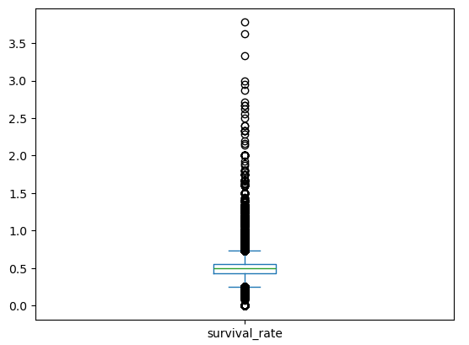
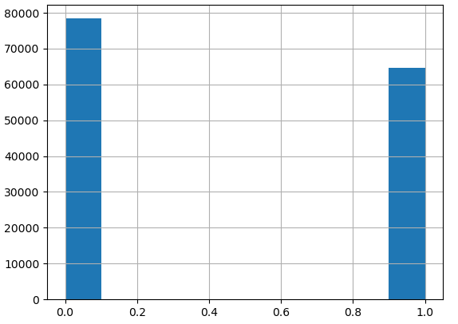
Survival Rate Results
Survival Class (.5 threshold)
Survival Rate
count | 149024
mean | 0.5028
std | 0.1488
min | 0
25% | 0.4351
50% | 0.4952
75% | 0.5541
max | 3.7778

Slide 8
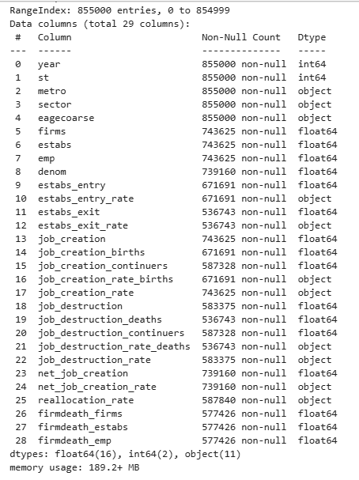
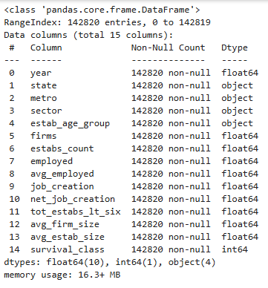
Data Cleaning
Original
Cleaned

Slide 9
Data Cleaning Summary
‘Collapsed’ the dataset into just young firms and their survival class
Removed any rows with age group 6 to 10, 11+, or Unknown
Lots of Missing Data
Due to How Data was collected, ended up missing many values for establishments in year 0
Job loss isn’t measured for establishments in year 0, only jobs created
Dropped columns where this was the case
Some areas just don’t have specific industries/non-metro areas to account for
Ex.) No Mining Establishments in DC
Last observation year = 2022
Only can see 6-10 year survival rate up to 2017

Slide 10
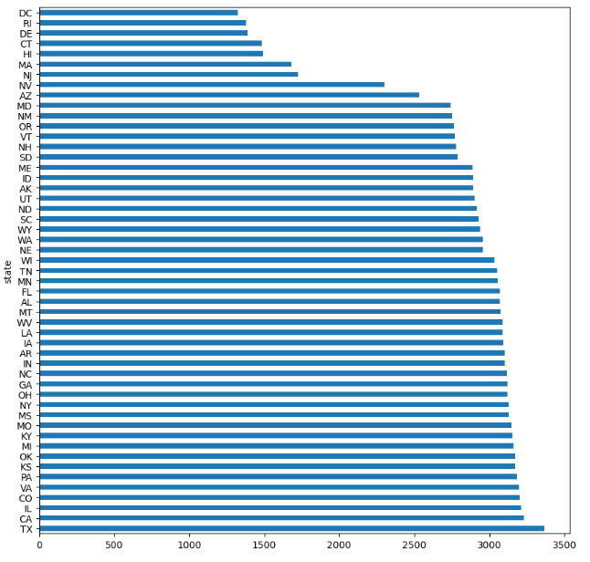
Data Cleaning
- All States Represented
Less data for smaller sates
Could indicate fewer active industries

Slide 11
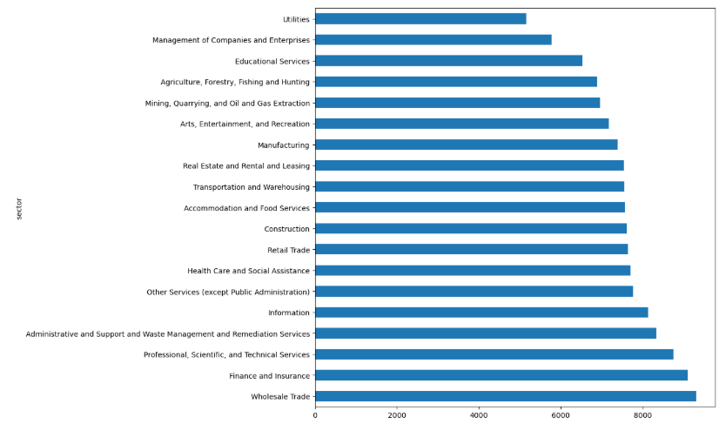
Data Cleaning
Share of Data by Sector

Slide 12
Modelling
Pre-Processing
Categorical Variables - One-Hot-Encoding
Numerical Variables - StandardScaler()
Classifier Models tested:
Random Forest Classifier
Support Vector Classifier
Logistic Regression
K-Nearest Neighbors Classifier
Gradiant Boosting Classifier
Quadratic Discriminant Analysis (QDA)
Train/Test Split
Time-series data
Data is ordered, need to preserve order to prevent ‘look ahead’ data leakage
Testing set 2012 – 2016 (~10%)
Training set 1978 – 2011 (~90%)
Evaluation
Training Time
Confusion Matrix
Classification Report
Ran reports for both Training / Test to evaluate bias

Slide 13
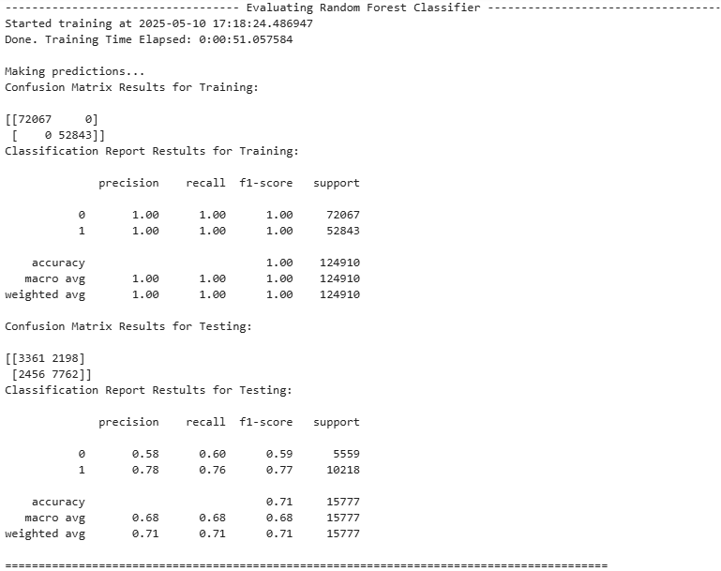
Random Forest
Training time is medium amongst all models
Evidence of overfitting due to results of training
Mild predictive capacity around 70%
Better at classifying category 1

Slide 14
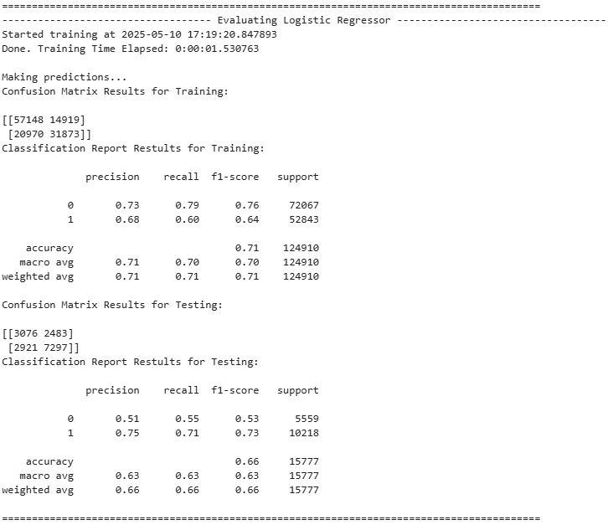
Logistic Regression
Training time was fast
Results from both training and testing suggest limited predictive capacity
Overfitting is unlikely for this model
Weak predictive capacity (66% accuracy)

Slide 15
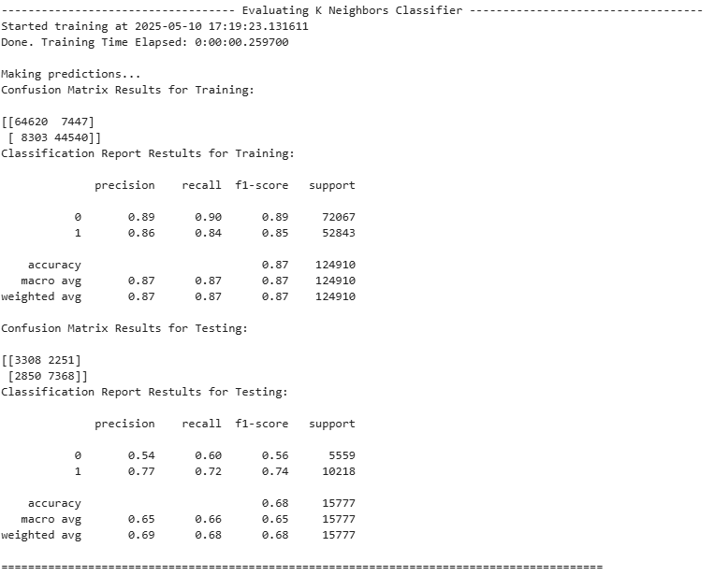
KNN Classifier
Training time was fast
Evidence of overfitting
Weak predictive capacity (68% accuracy)

Slide 16
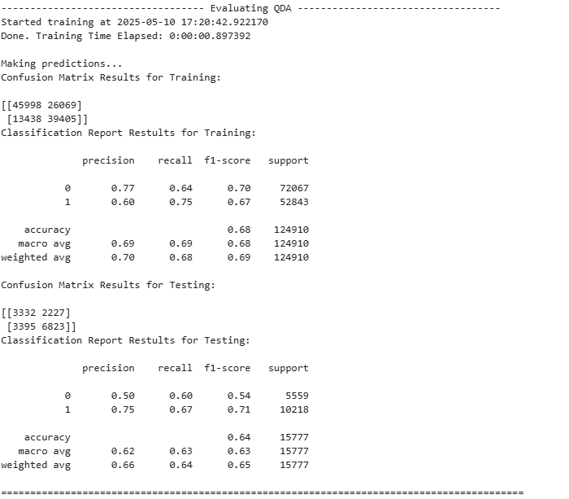
QDA

Slide 17
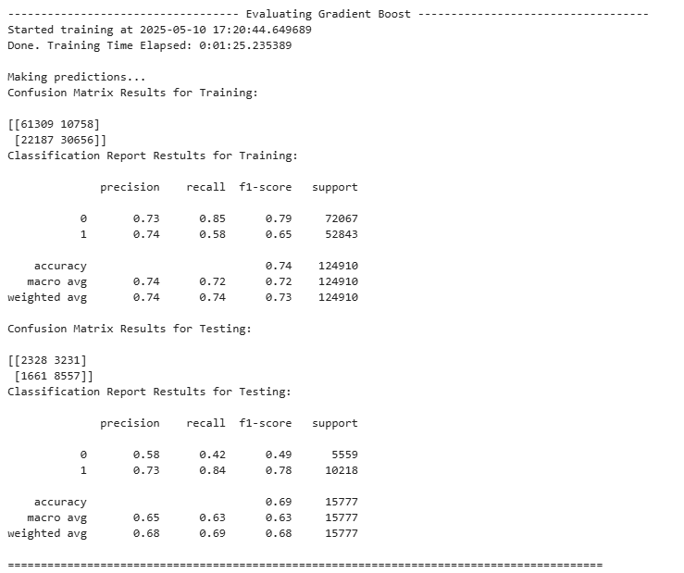
Gradient Boost

Slide 18

Tuning – Random Forest Classifier
3 Approaches for improving our Model:
Adjusting the years in the training data
It could be the case that we're including too much 'old data' for training.
The U.S. Economy fundamentally changed from 1978-2016, and the old indicators may not be useful in predicting modern trends.
Reduce overfitting by adjusting hyperparameters
Cross-validating our model

Slide 19
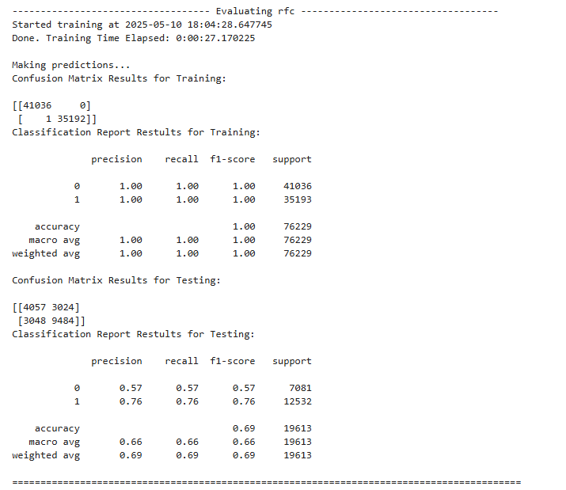
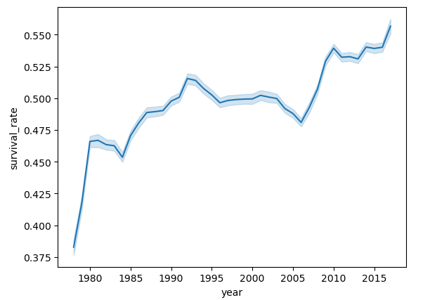
Trimming Training Years
Did observe changes of survival rate across year in our dataset.
Dropped data prior to 1990 in training set
Did not really improve our model…

Slide 20
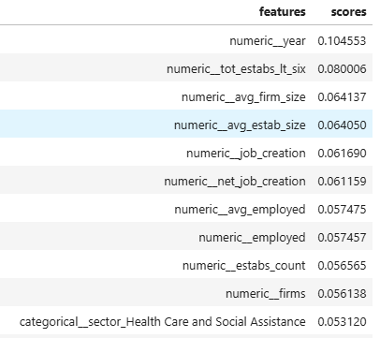
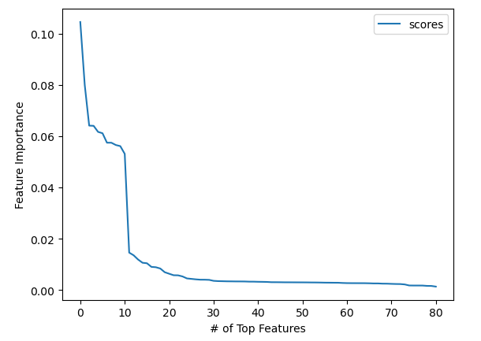
Adjusting Hyperparameters
Feature importance drops after 10

Slide 21
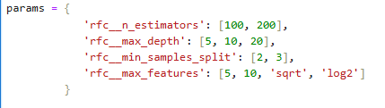
GridSearchCV
Parameter Grid:
CV Method Due to Time Series: TimeSeriesSplit(n_splits = 2)
Results:

Slide 22
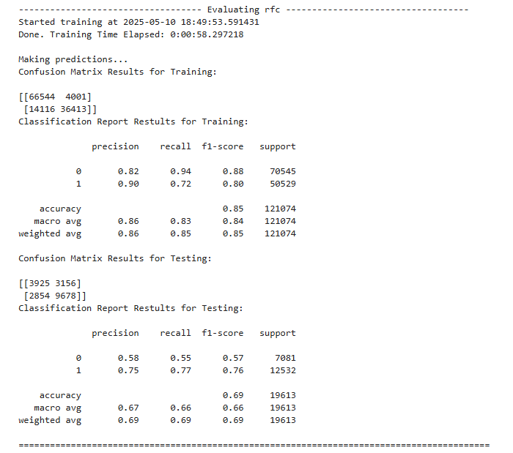
Re-Testing Model
Reduced Training Accuracy (attempt to reduce overfitting)
Accuracy score is still about .70

Slide 23
Conclusion
Best Model was Random Forest Classifier but could not get accuracy above 70% after tuning.
Not great, but not a total failure
Seems possible to predict survival rate, if macro-economic data, and geographical data is known
Underlying issue with our dataset
Suspect that too much data was removed from our initial dataset.
Time-series is challenging. ‘Temporal Drift’ is possible. Ie features that are important in earlier years, not as important in later years.
Economic recessions could skew data.
Better survey methods

Slide 24
Suggestions for Next Steps
Re-work methodology for Survival Rate, and classification
Adjust threshold to assign the binary class, Maybe better results if just looking at establishments with .7 survival rate or above
Since Establishment Age Data is binned (1-5 years) in our case, use average of future ‘survived establishment count’ across 5-year range, instead of data from a singular cut-off year
Assign more classes instead of 0 or 1
Better data cleaning, feature engineering
Added 2 engineered features (Average Firm Size, and Average Establishment size), which were amongst the most significant features in our model. Could continue to add features that make economic sense (Total Establishments across all age groups etc.)
Replace missing data with averages instead of dropping columns.
Weighing recent years in our dataset more heavily while training to address ‘Temporal Drift’
Trying more Models

